Slide 1
The University of Texas at Arlington The Department of Computer Science and Engineering CSE 5369 – SPECIAL TOPICS IN INTELLIGENT SYSTEMS
Human Activity Recognition to assist
Elderly people
PROJECT ITERATION: FINAL
Geethika Lingamaneni
Bhargavi Boppana
Gayathri Gottipolu

Slide 2
Introduction-Motivation
Fall prevalence increases with age globally and is actually considered an important health problem. They often require immediate medical attention since they lead to 20–30% of mild to severe injuries or even death.
Falls are one of the most dangerous situations for elderly people at home and leading reason for injury related hospitalization.
Falls exponentially increase with age-related biological changes, which is leading to a high incidence of falls and fall related injuries in the ageing societies.
People who lay on the floor for more than an hour, died within six months after the fall, even though the person did not suffer any direct phyical injury.

Slide 3
Related Work
M. D. Solbach and J. K. Tsotsos, "Vision-Based Fallen Person Detection for the Elderly," 2017 IEEE International Conference on Computer Vision Workshops (ICCVW), Venice, 2017, pp. 1433-1442.
https://ieeexplore.ieee.org/document/8265380
→ This paper presents the idea of a novel fallen person detector system based on stereo vision using state of-the-art 2D human person detection, extended it to achieve 3D key point information and also ground plane information.
→ We could get an insight of fall detection using stereo camera and combining of 2d key points and depth image data to estimate 3d pose in order to detect the fall.

Slide 4
Related Work
A. Jalal, Y. Kim, S. Kamal, A. Farooq and D. Kim, "Human daily activity recognition with joints plus body features representation using Kinect sensor," 2015 International Conference on Informatics, Electronics & Vision (ICIEV), Fukuoka, 2015, pp. 1-6.
https://ieeexplore.ieee.org/abstract/document/7334030
→ In this paper, they proposed a new feature representation and extraction method using a sequence of depth silhouettes.
→ Particularly, we first extract the depth silhouette by removing background from noisy effects and then extract the joints plus body features as skin color detection from joint information and multi-view body shape from depth silhouettes (i.e., front and side views).
→ We combine the joints plus body shape features to make feature vector. These features have two nice properties including invariant with respect to body shape or size and insensitive to small noise. Self-Organized Map (SOM) is then used to train and test the feature vectors

Slide 5
Related Work
Singh D. et al. (2017) Human Activity Recognition Using Recurrent Neural Networks. In: Holzinger A., Kieseberg P., Tjoa A., Weippl E. (eds) Machine Learning and Knowledge Extraction. CD-MAKE 2017. Lecture Notes in Computer Science, vol 10410. Springer, Cham
→ This paper introduces a deep learning model that learns to classify human activities without using any prior knowledge. For this purpose, an LSTM - RNN was applied to three real-world home datasets and proves the proposed approach outperforms existing ones in terms of accuracy and performance.

Slide 6
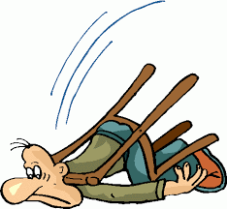

Project Goals (Final)
To monitor and detect the simple activities of a person using a Kinect Sensor.
Recognize Simple Human Actions.
Falling
Standing
Walking
Sending Email and Text notification when ever a fall is occurred.
A simple GUI to start the webcam , set alternate email address and to display model results.

Slide 7
System Architecture
Camera
GUI
Input Data Frames
Activity Recognition
Data Preprocessing
Fall Detected
Alert (Email and Text)
→ Falling
→ Standing
Walking
Feature Extraction

Slide 8
Developed Approach-Methodology
Fall detection:
Data: Online Action dataset that includes actions like stand, walk, run, operate and fall.
Input: Kinect Camera / Webcam
Data Preprocessing: We are using VGG_16 model to extract features from video which work likes Pose estimation and then extracts features.
VGG_16 helps in extracting Body keypoints from each frame of the video and extracted features are then send to machine learning or deep learning model to predict between 3 classes (stand, walk and fall down).
Model: First of all we have to train our models to generate model file.
We are using Support Vector Machine, K-Nearest Neighbor, Decision Tree and Artificial Neural Network to compare results. We are using 5-Fold cross validation on all these models.
After training our model, we then tested on live webcam to see performance of models on real time.

Slide 9
Continuation:
Notification: If the predicted class is fall down the system will send an alert on email as well as mobile notification to specified email and mobile number.
We also have an alternative email option where system will send an alert to email to both mails and mobile number.
We have used STMP library to send an alert on email and twilio library to send an alert on mobile number as SMS.

Slide 10
Continuation:
GUI: A GUI is built where it provides the following options
To start the webcam,
To display results of the models.
It also provides an option in the toolbar to set an alternate email address and reset to default address.

Slide 11
Study design or Experimental Setup
For the experimental setup, we have used Kinnect camera connected to our laptop.
To test the project, we have asked few of our friends to try this.
We have initially explained the whole process of what and how it should be done.
Once they are aware of the entire process, we asked them to be in front of the experimental setup and perform few activities like stand, walk and fall.
Our project is able to detect the activities accurately most of the times and it is able to send an email and text notification when there is fall.
We have tested this on 6-7 people and were able to get the fall detection and notifications being sent correctly at all the times.

Slide 12
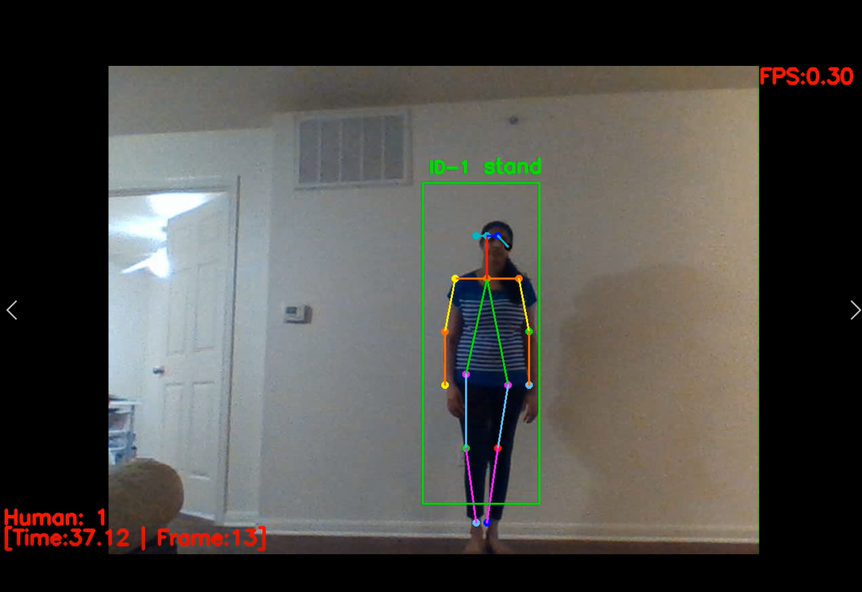
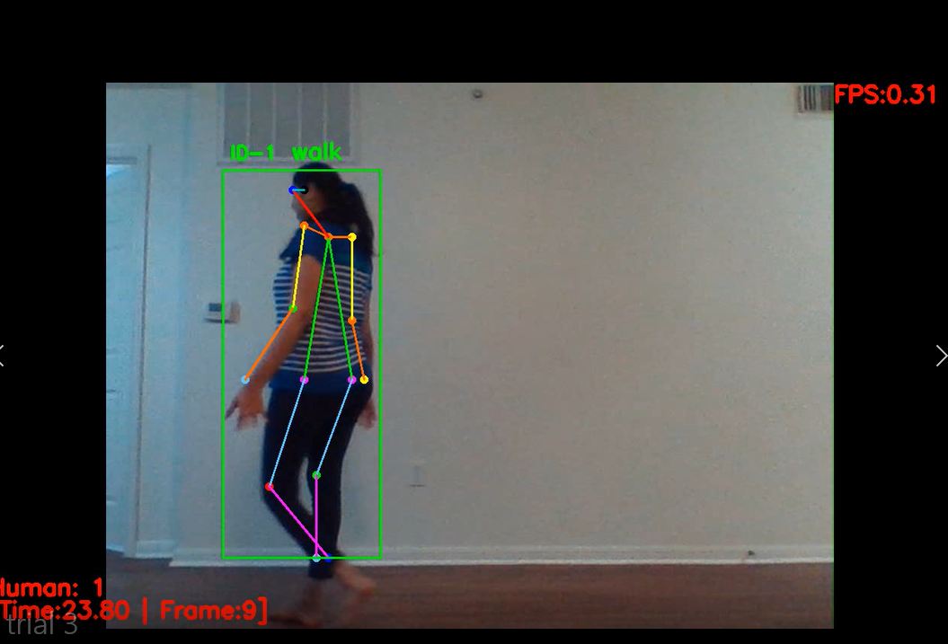
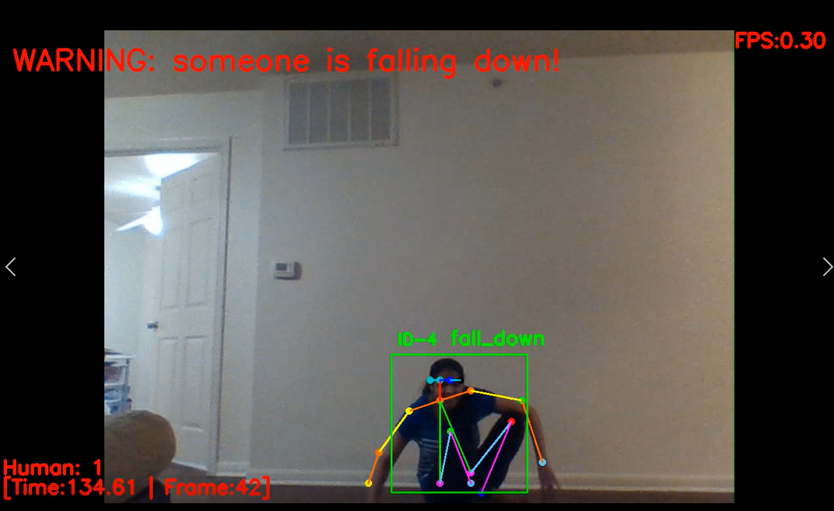
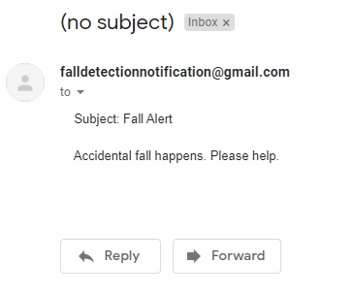
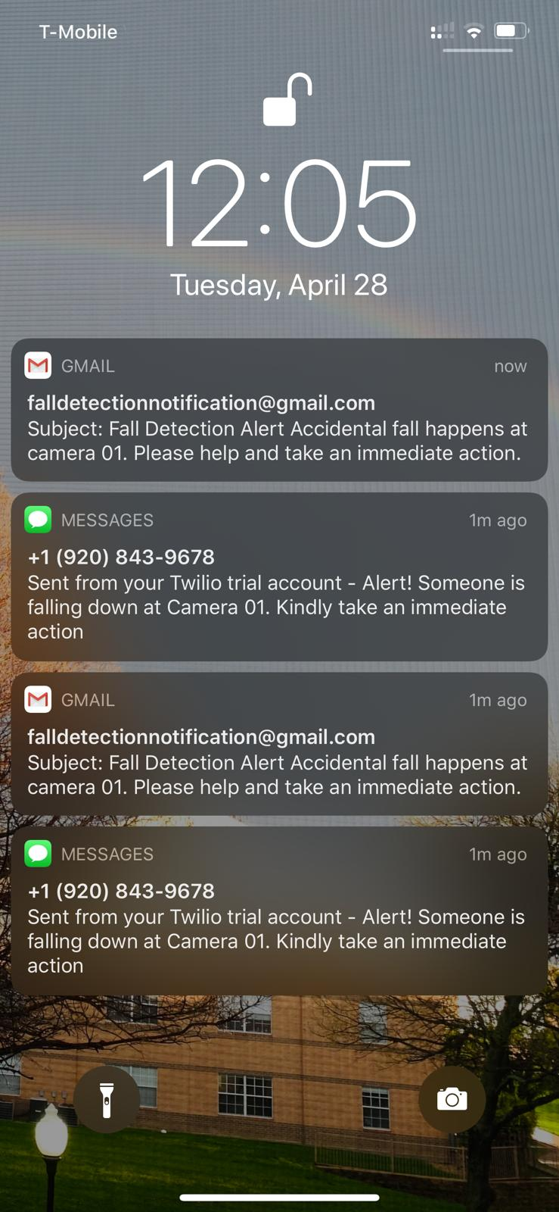

Slide 13
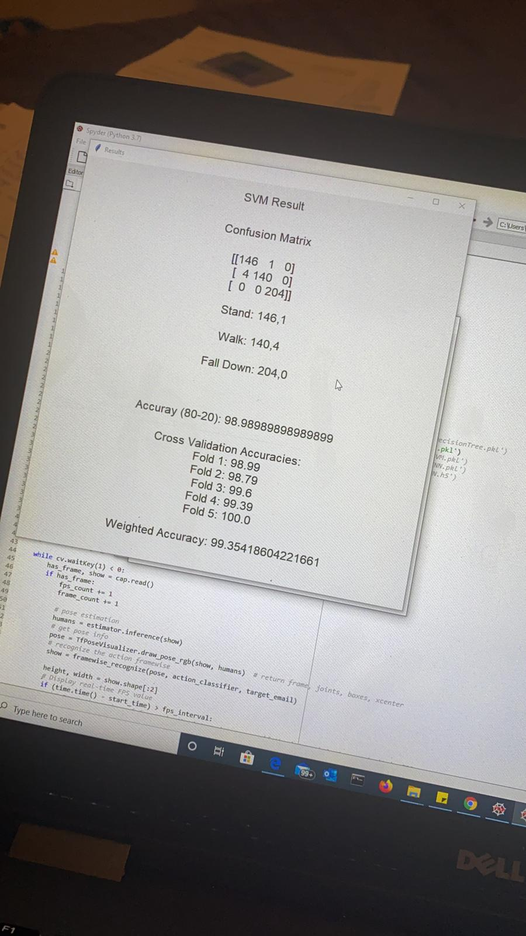
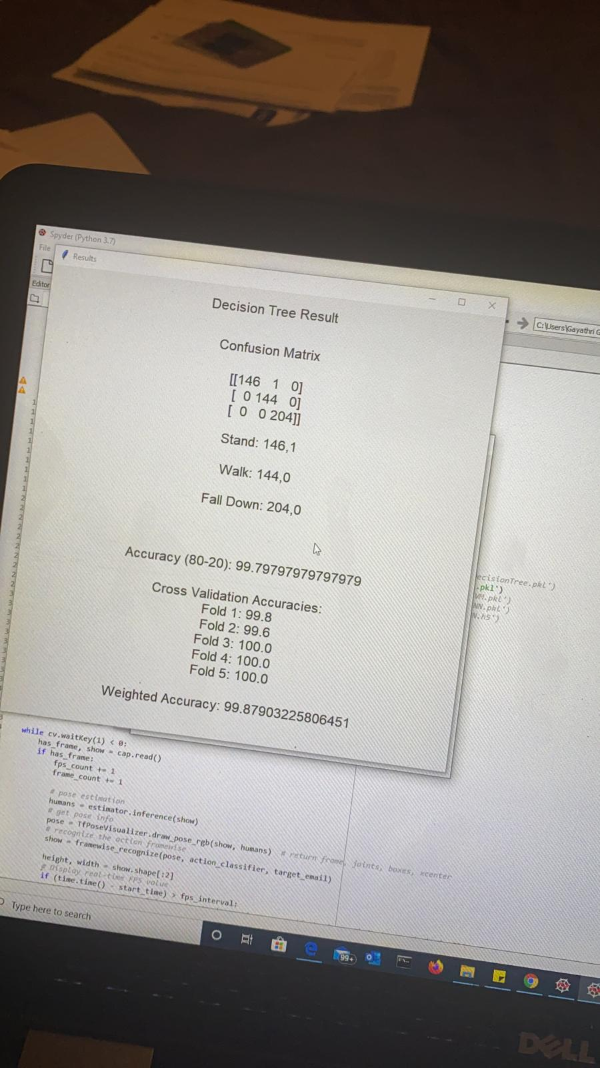
System Evaluation (User Feedback Surveys, Results, Evaluation metrics, and Discussion)
MODEL EVALUATION

Slide 14
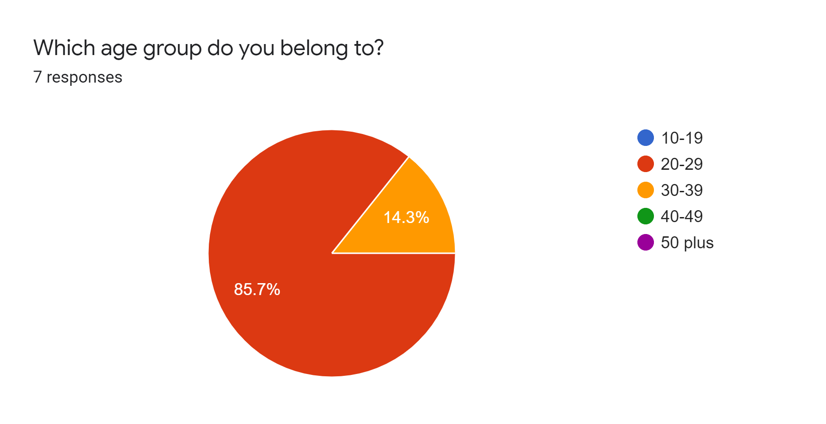
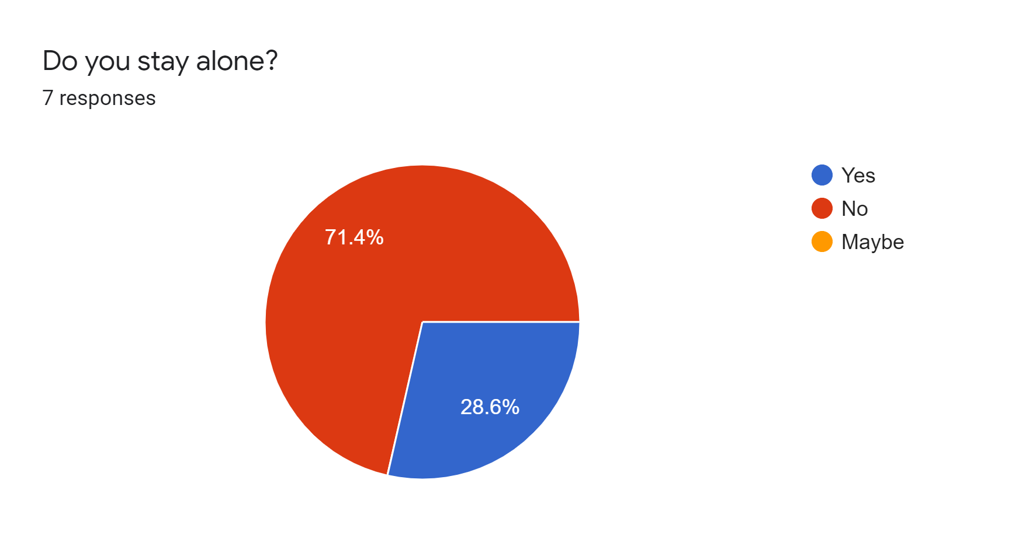
User Feedback survey
We asked our friends and roommates to take part in this experiment and give their feedback.
The feedback which we got:

Slide 15
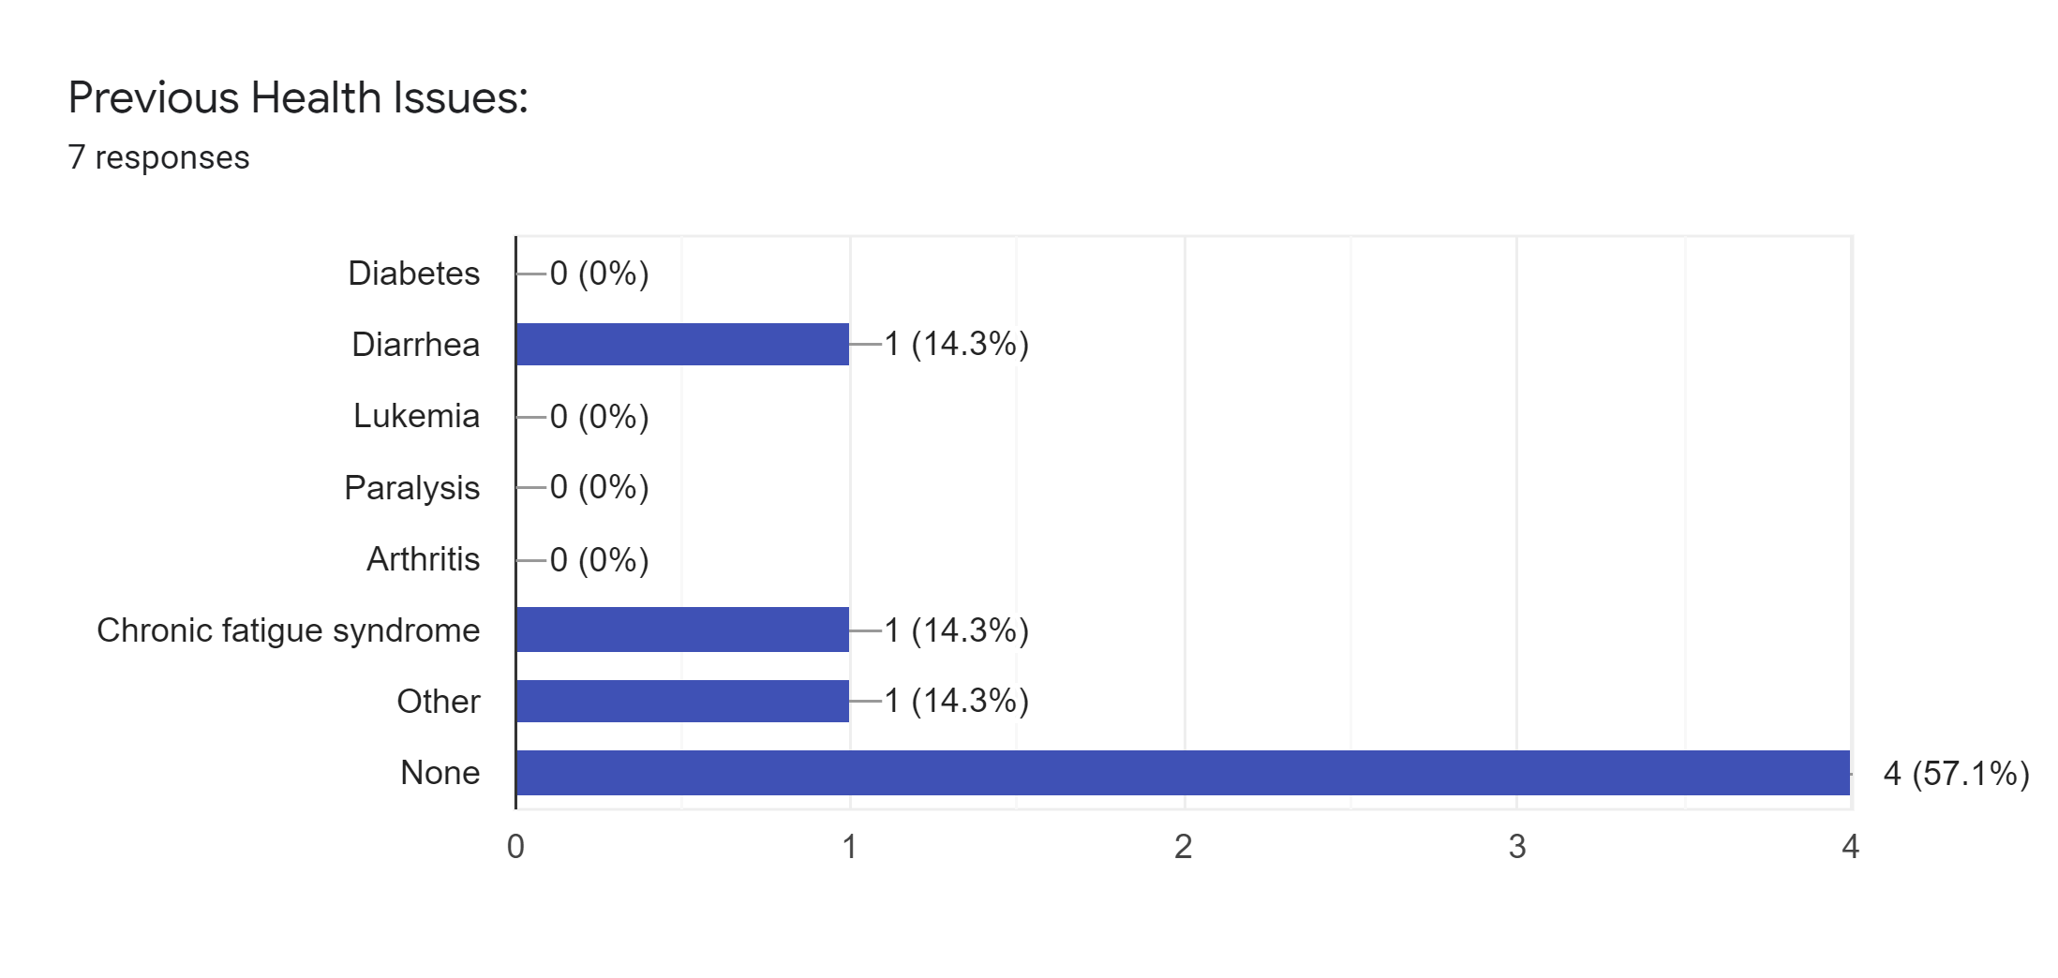
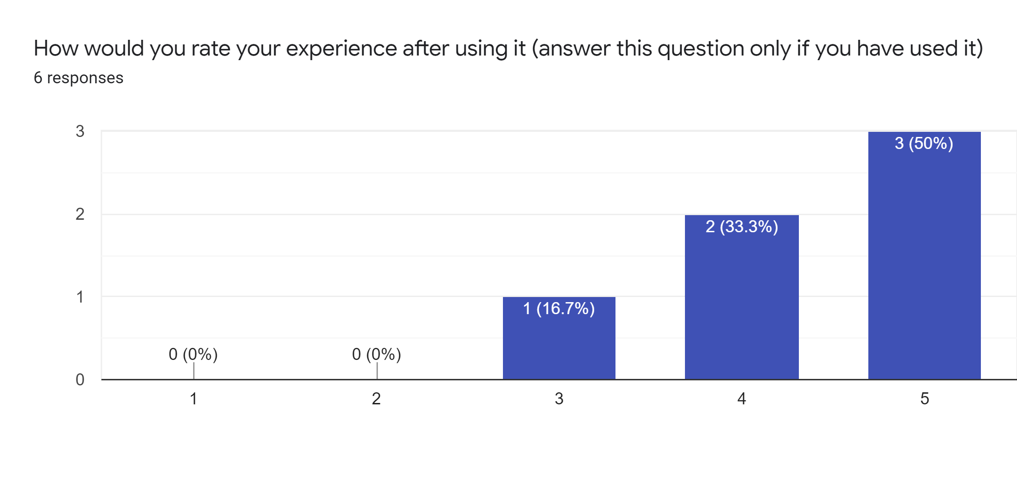
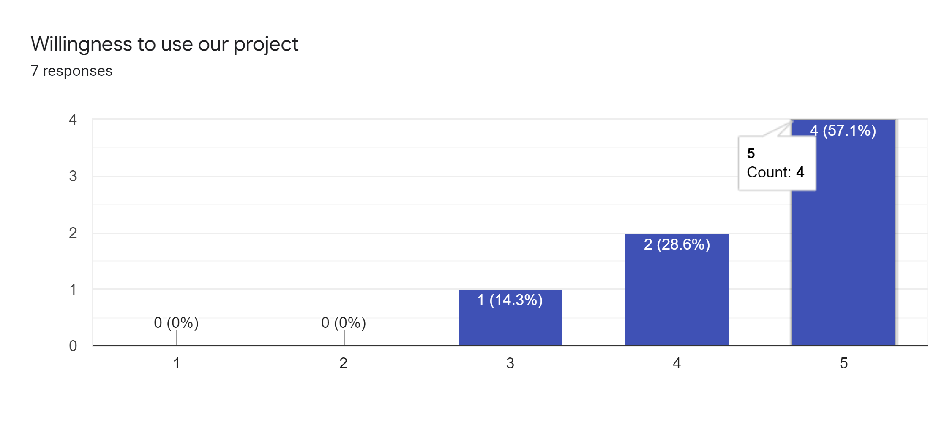

Slide 16
Demo

Slide 17
Conclusion & Future Work
In this project, we have classified few activities like stand, walk, fall, run and operate. And then when ever a fall is detected, a notification through email or text is sent to the concerned people so that immediate help can be provided. We have used various models to test the accuracy of this system and the results are presented using the confusion matrix and 5 fold cross validation.

Slide 18
Role Designation
Task | Done by
Background Research | Geethika, Bhargavi, Gayathri
Working on Open pose | Geethika, Bhargavi, Gayathri
Setting up Kinect | Geethika and Bhargavi
Classification of activities(Pre trained model) and Model evaluation. | Gayathri
Email and Text notifications and Email related changes in GUI | Geethika
GUI to start the webcam and display the results | Bhargavi
User Feedback Survey | Geethika
18

Slide 19
References
O. C. Ann and L. B. Theng, "Human activity recognition: A review," 2014 IEEE International Conference on Control System, Computing and Engineering (ICCSCE 2014), Batu Ferringhi, 2014, pp. 389-393.
Chin Ann, Ong & Lau, Bee. (2015). Human activity recognition: A review. Proceedings - 4th IEEE International Conference on Control System, Computing and Engineering, ICCSCE 2014. 389-393. 10.1109/ICCSCE.2014.7072750.
Sang V.N.T., Thang N.D., Van Toi V., Hoang N.D., Khoa T.Q.D. (2015) Human Activity Recognition and Monitoring Using Smartphones. In: Toi V., Lien Phuong T. (eds) 5th International Conference on Biomedical Engineering in Vietnam. IFMBE Proceedings, vol 46. Springer, Cham
Delahoz, Yueng & Labrador, Miguel. (2014). Survey on Fall Detection and Fall Prevention Using Wearable and External Sensors. Sensors (Basel, Switzerland). 14. 19806-19842. 10.3390/s141019806.

Slide 20
References
M. D. Solbach and J. K. Tsotsos, "Vision-Based Fallen Person Detection for the Elderly," 2017 IEEE International Conference on Computer Vision Workshops (ICCVW), Venice, 2017, pp. 1433-1442.
Z. Cao, G. Hidalgo Martinez, T. Simon, S. Wei and Y. A. Sheikh, "OpenPose: Realtime Multi-Person 2D Pose Estimation using Part Affinity Fields," in IEEE Transactions on Pattern Analysis and Machine Intelligence.
Ahmad Jalal, Yeonho Kim, Shaharyar Kamal, Adnan Farooq and Daijin Kim “Human daily activity recognition with joint plus body features representation using Kinect sensor.”
Singh D. et al. (2017) Human Activity Recognition Using Recurrent Neural Networks. In: Holzinger A., Kieseberg P., Tjoa A., Weippl E. (eds) Machine Learning and Knowledge Extraction. CD-MAKE 2017. Lecture Notes in Computer Science, vol 10410. Springer, Cham

Slide 21


